Slide 1


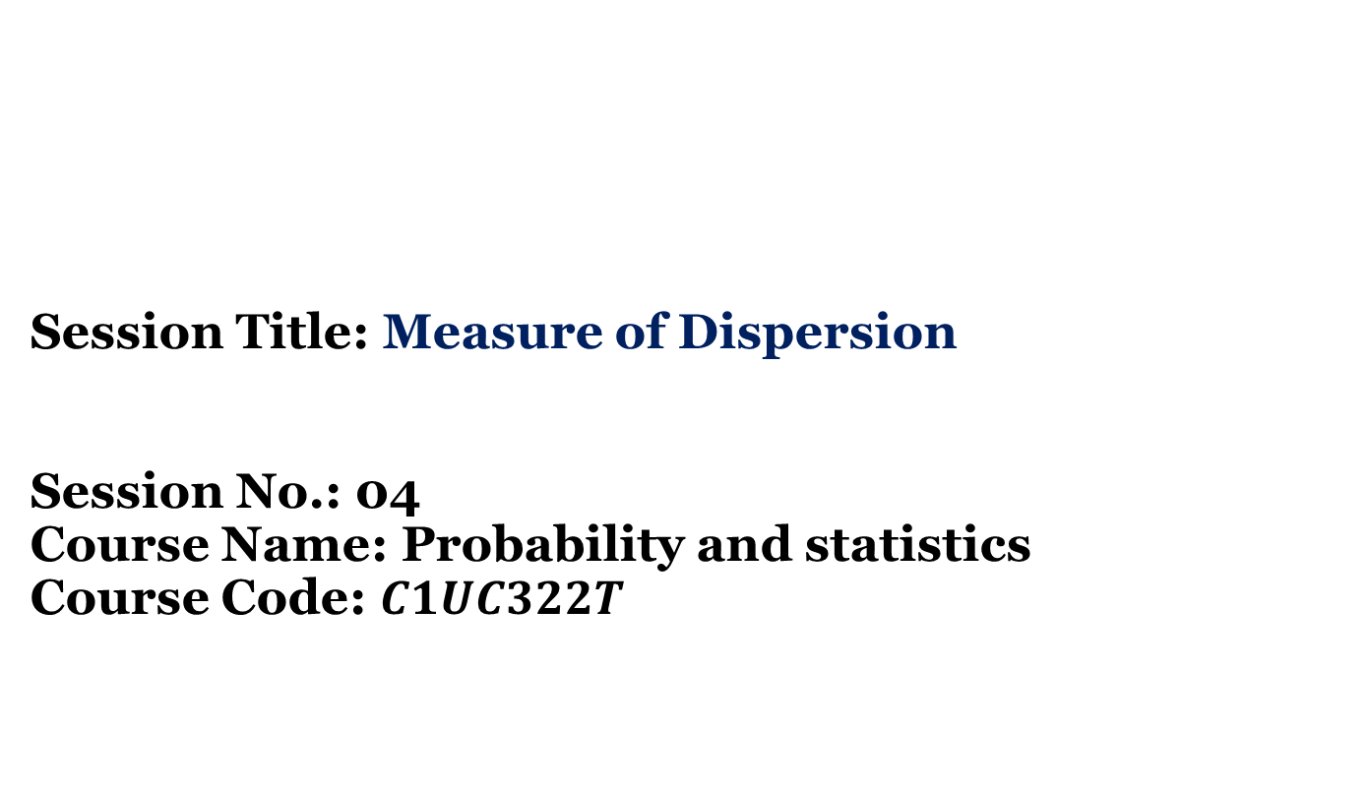
Session Title: Measure of Dispersion Session No.: 04 Course Name: Probability and statistics Course Code: $C1UC322T$

Slide 2
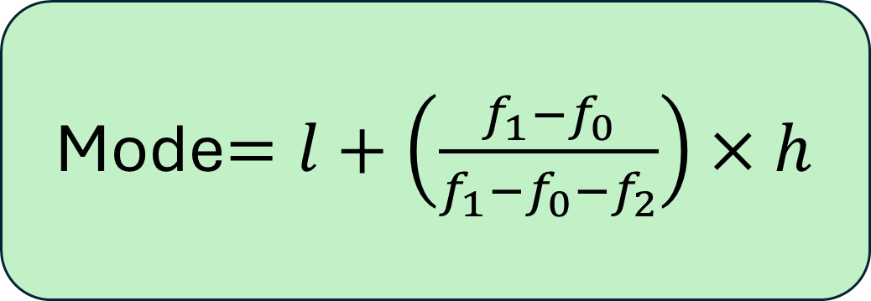
Review of the key concepts of session no. 3
Mode$=l+\left(\frac{f_{1}−f_{0}}{f_{1}−f_{0}−f_{2}}\right)×h$

Slide 3
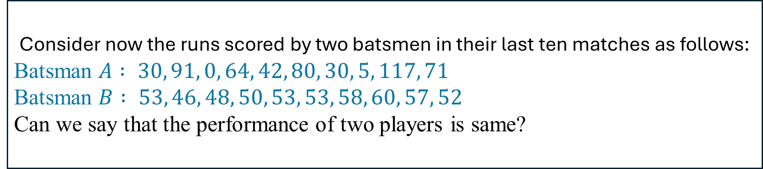
Opening Activity
Consider now the runs scored by two batsmen in their last ten matches as follows:
Batsman $A : 30, 91, 0, 64, 42, 80, 30, 5, 117, 71$
Batsman $B : 53, 46, 48, 50, 53, 53, 58, 60, 57, 52$
Can we say that the performance of two players is same?

Slide 4
What are the mean and median of both the data?
Batsman A Batsman B
Mean
53
53
Median
53
53
Can we say that the performance of two players is same? Discuss among your group.

Slide 5
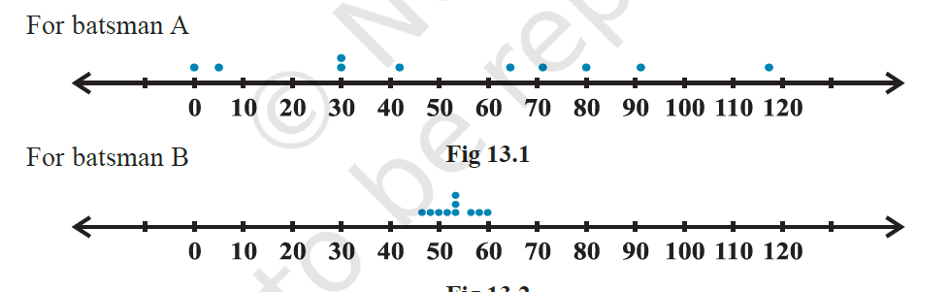
Plot of the scores as dots on a number line. We find the following diagrams:
What can you say about their scores after looking at the dots?

Slide 6
We can see that the dots corresponding to batsman B are close to each other and are clustering around the measure of central tendency (mean and median), while those corresponding to batsman A are scattered or more spread out.
Thus, the measures of central tendency are not sufficient to give complete information about a given data. Variability is another factor which is required to be studied under statistics. Like ‘measures of central tendency’ we want to have a single number to describe variability. This single number is called a ‘measure of dispersion’.

Slide 7
At the end of this session students will be able to At the end of this lesson, students will be able to
1. Recognize the concept of measure of dispersion
2. Calculate range, Mean deviation and Standard deviation

Slide 8
Session Outline
1 Discussion on engaging question
2 Introduction of Measure of Dispersion
3 Range and Mean Deviation
4 Variance and Standard Deviation

Slide 9
Measures of Dispersion
The measure of dispersion is a statistical tool that quantifies the extent to which data values spread around a central value (such as the mean or median). It helps assess the variability, consistency, and reliability of a dataset. Types of Measures of Dispersion:
Range
Mean Deviation
Standard Deviation

Slide 10
Range: Range of a series or set of data = Maximum value – Minimum value.
For example, in the opening question,
In case of batsman A, Range = 117 – 0 = 117 and for batsman B, Range = 60 – 46 = 14.
Clearly, Range of A > Range of B. Therefore, the scores are scattered or dispersed in
case of A while for B these are close to each other.
Note that: The range of data gives us a rough idea of variability or scatter but does not tell about the dispersion of the data from a measure of central tendency.

Slide 11
Mean Deviation
Recall that the deviation of an observation x from a fixed value ‘a’ is the difference
x – a.
The mean deviation about a central value ‘a’ (mean or median) is the mean of the absolute values of the deviations of the observations from ‘a’. The mean deviation from ‘a’ is denoted as M.D. It Shows how much data values deviate from the mean or median and compared to range, it provides a better sense of variability.
Compare with the Mean or Median
If the mean deviation is relatively small compared to the mean/median, the data points are closely packed (less dispersion).
If the mean deviation is large, the data points are widely spread (high

Slide 12

Formulas: 1. For Individual data: Let n observations be $x_{1}, x_{2}, x_{3}, ….,x_{n}$. Then $M.D=\frac{1}{n}\sum_{i=1}^{n}{|x_{i}−a|}$, Where a is mean or median.
2. For Discrete with frequencies: Let n observations be $x_{1}, x_{2}, x_{3}, ….,x_{n} with their frquencies f_{1},f_{2},f_{3},……..f_{n}$ Then
$M.D=\frac{\sum_{i=1}^{n}{f_{i}.|x_{i}−a|}}{\sum{f_{i}}}$ , Where a is mean or median.
3. For Continuous data: Let n be the class intervals $with their frquencies f_{1},f_{2},f_{3},……..f_{n}$ Then
$M.D=\frac{\sum_{i=1}^{n}{.f_{i}|x_{i}−a|}\text{,}}{\sum{f_{i}}}$Where a is mean or median and $x_{1}, x_{2}, x_{3}, ….,x_{n} be the mid values of the class intervals$

Slide 13

Problem: Find the mean deviation about the mean for the following data:
6, 7, 10, 12, 13, 4, 8, 12
Step-1: Compute the mean ($\overline{x}$=9)
Step-02: Find Deviations ${|x}_{i}−\overline{x|}$
3, 2, 1, 3, 4, 5, 1, 3
Step-03: $M.D.\left(\overline{x}\right)=\frac{22}{8}$

Slide 14
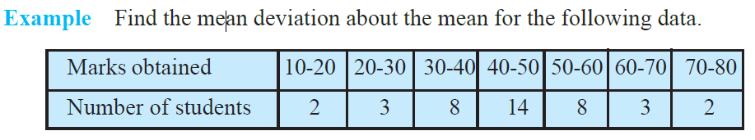
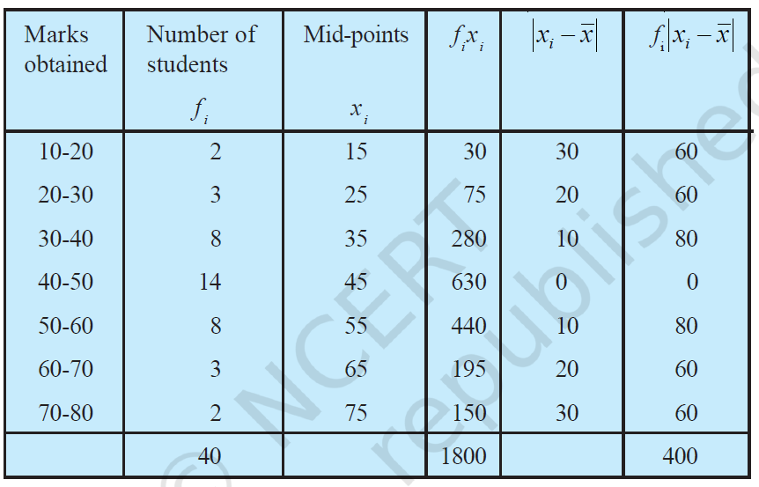
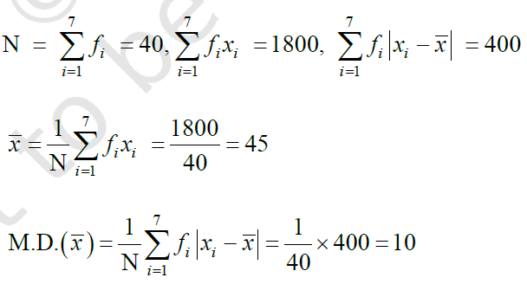

Slide 15

Activity 1 Pen Paper Activity
Find the mean deviation about the mean for the following data:
x | 10 | 20 | 30 | 40 | 50
f | 4 | 6 | 8 | 10 | 12
Reflection

Slide 16
Variance : Variance is one of the most important measures of dispersion, which tells us how much the data values spread out from the mean. It helps in understanding the degree of variability in a dataset. Note: 1. A low variance means data points are closely packed around the mean (less variability). 2. A high variance means data points are widely spread out (high variability).

Slide 17
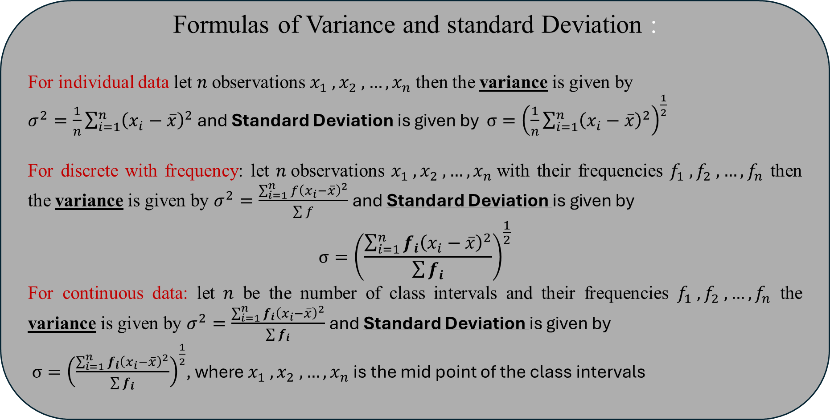
Formulas of Variance and standard Deviation :
For individual data let $n$observations $x_{1} , x_{2} ,…, x_{n}$then the variance is given by
$σ^{2}=\frac{1}{n}\sum_{i=1}^{n}{{\left(x_{i}−\overline{x}\right)}^{2}}$ and Standard Deviation is given by $σ={\left(\frac{1}{n}\sum_{i=1}^{n}{{\left(x_{i}−\overline{x}\right)}^{2}}\right)}^{\frac{1}{2}}$
For discrete with frequency: let $n$observations $x_{1} , x_{2} ,…, x_{n}$with their frequencies $f_{1} , f_{2} ,…, f_{n}$ then the variance is given by $σ^{2}=\frac{\sum_{i=1}^{n}{f{\left(x_{i}−\overline{x}\right)}^{2}}}{\sum{f}}$ and Standard Deviation is given by
$$σ={\left(\frac{\sum_{i=1}^{n}{f_{i}{\left(x_{i}−\overline{x}\right)}^{2}}}{\sum{f_{i}}}\right)}^{\frac{1}{2}}$$
For continuous data: let $n$ be the number of class intervals and their frequencies $f_{1} , f_{2} ,…, f_{n}$ the variance is given by $σ^{2}=\frac{\sum_{i=1}^{n}{f_{i}{\left(x_{i}−\overline{x}\right)}^{2}}}{\sum{f_{i}}}$ and Standard Deviation is given by
$σ={\left(\frac{\sum_{i=1}^{n}{f_{i}{\left(x_{i}−\overline{x}\right)}^{2}}}{\sum{f_{i}}}\right)}^{\frac{1}{2}}$, where $x_{1} , x_{2} ,…, x_{n}$ is the mid point of the class intervals

Slide 18
Problem. Let's solve the variance and standard deviation for the given frequency distribution:data:
Marks | 10 - 20 | 20 - 30 | 30 - 40 | 40 - 50 | 50 - 60
frequency | 5 | 8 | 12 | 10 | 7

Slide 19
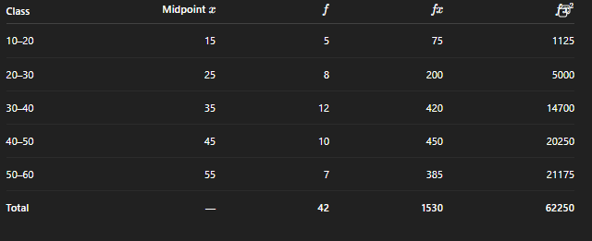

Reflection

Slide 20
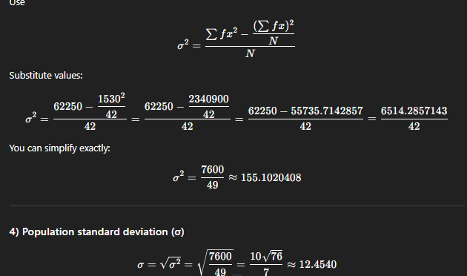

Slide 21
Activity 2 Problem Base learning
Find the variance and standard deviation of the following data:
6, 8, 10, 12, 14, 16, 18, 20, 22, 24
Answer
Variance=33
S.D=5.74

Slide 22
Exit Ticket What is the need of studying variance and standard deviation?

Slide 23
In the next lecture we will learn the concept of Curve fitting with least square method

Slide 24
Review and Reflection from students

